Slide 1
A Remote PSA Attendees Guide to
Taylor Langford, M.S.
Education and Training Specialist II
University of Florida , FSHN

Slide 2
Audio
Mute audio at all times, unless speaking.

Slide 3
Video
Video must be turned on at all times, except during breaks.
Attendance and engagement will be monitored throughout the course and you must be visible to the presenters to be eligible to receive the PSA/AFDO certificate of course completion.

Slide 4
Rename Yourself
Click participants on the tool bar at the bottom of your screen.
Hover over your name, click “More” and then “Rename"

Slide 5
Chat Box
Click “Chat" on the tool bar at the bottom of your screen.
The dialogue box will pop up on the right side.
If asking a question, please address it to “Everyone”.

Slide 6
Polling
Please complete the entire poll as the questions pops up on your screen.
Polls are used to monitor engagement and test your understanding of the material that is being presented. Polls are anonymous and do not affect if you receive a certificate from this course.

Slide 7
Other Course Information
Certificates will be issued by the Association of Food and Drug Officials
If you do not receive your certificate in ~2 weeks, please contact us.
Course Evaluations
A link will be shared via email on the last day. Important feedback for future courses.
Produce Safety Alliance Grower Training Manuals
Everyone must have a manual to participate and receive a certificate for this training.

Slide 8
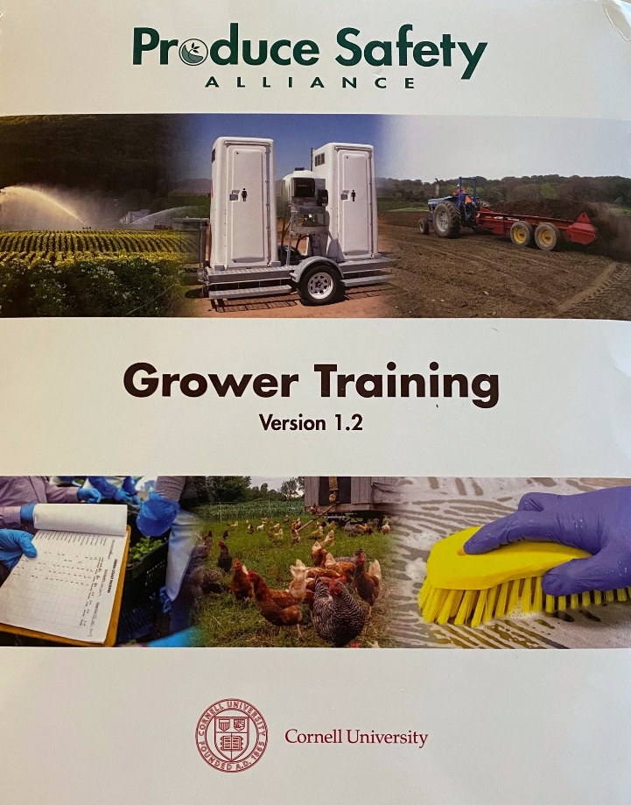
Produce Safety Alliance Grower Training Manual
Welcome
Modules 1-7
References and Resources
Glossary
Bold Terms
FSMA Produce Safety Rule
Written language and Reference Table
FDA and USDA Resources

