Slide 1
What is the difference between an average and a Geometric Mean (GM)?
SUPPLEMENTAL MATERIAL
Notes:
The following slides will walk participants through the calculations for an average and a GM.

Slide 2
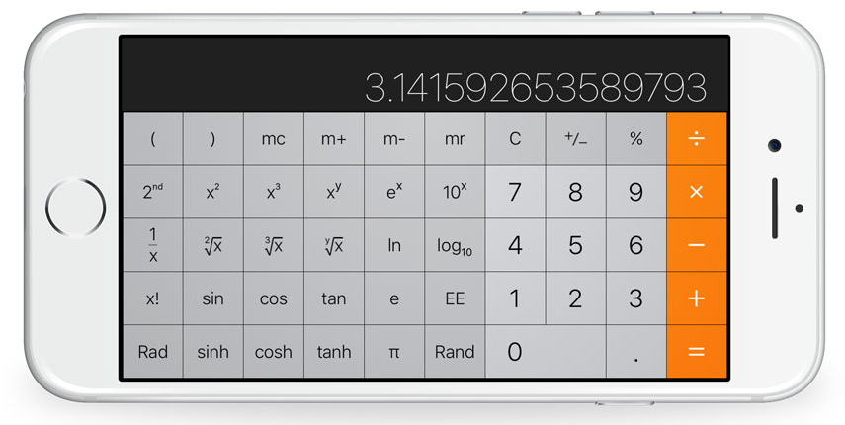
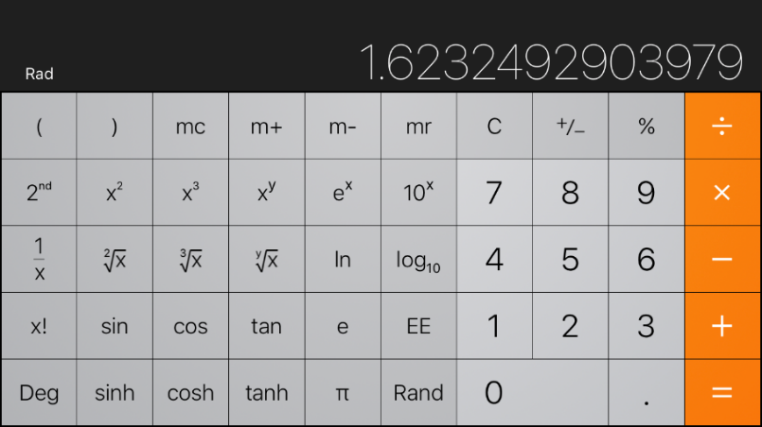
SUPPLEMENTAL MATERIAL
Notes:
To calculate the GM, growers will need to find the log and antilog functions on a calculator. Typically, they can be located by turning a cell phone calculator on its side.

Slide 3
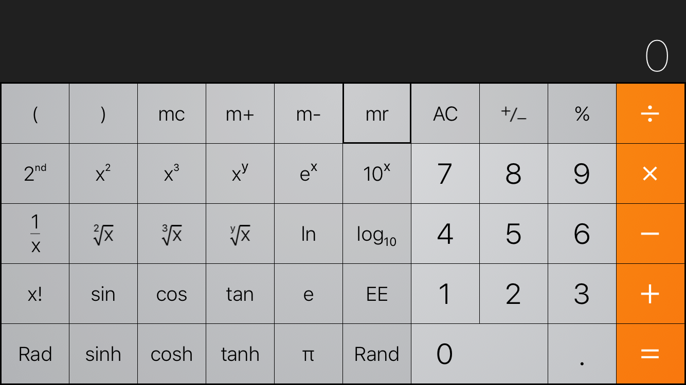
“antilog” button
“log” button
SUPPLEMENTAL MATERIAL

Slide 4
Why use a Geometric Mean?
Example using two test results:
10 CFU/100 mL and 1,000 CFU/100 mL
The average calculation
The average of 10 and 1,000 = 505
505 is above the GM criterion of 126
The GM calculation
Log(10) = 1 and Log(1,000) = 3
The average of 1 and 3 = 2
The antilog of 2 = 100
100 is less than the GM criterion of 126
SUPPLEMENTAL MATERIAL
Notes:
Using the Geometric Mean benefits the grower by making rare high values less important to the result. When compared to the average, the GM calculation is in the grower’s favor.
Note that a MWQP must contain at least 4 samples for ground water and at least 20 samples for surface water. We used two samples to simplify the math for this example.

